Slide 1
Study to examine the links between corruption and organised crime
Alexander Stoyanov, Ruslan Stefanov & Philip Gounev
Center for the Study of Democracy
Brussels, 13 July 2010

Slide 2
Content
CSD presentation
Objectives and context of the study
Methodology of the study
Organised crime and corruption
Institutional perspectives
Market perspectives
Member state perspectives
Case study - France
Recommendations

Slide 3
Services and activities
Research
Economic
Legal
Public awareness
Conferences
Round-tables
Policy impact
European Commission
Bulgarian government
Sociological
Foreign governments
Media training

Slide 4
CSD Research
Legal
Legislation drafting
Legal analysis (judicial reform)
Sociological
Social surveys
Political analysis
Security
Security sector reform, arms control
Organised crime and illegal markets
Economic
Grey economy
Competiveness, innovation

Slide 5
Funding, support, and clients
Over $6 million in grants on economic development, anti-corruption, crime research
Criminal justice reform, organised crime research
Crime-victims surveys (ICVS, IBCS)
Directorate General “Justice Freedom and Security”: contract research, AGIS , ISEC, FRA
FP7 Research: public confidence in justice; prisons and drugs

Slide 6
Objectives
Take stock of existing studies on the link
Identify the factors that bring about the use of corruption by organised crime within the public and private sectors
provide a framework for future assessment of the trends in the how corruption is used by organised crime
provide a framework for future assessment of the effectiveness of the various preventive and repressive measures

Slide 7
EU Context
The Hague and the Stockholm Programmes
Europol’s efforts: OCTA reports
The EC Staff Working paper: An examination of the links between organised crime and corruption
Lisbon treaty
Domestic political agendas
Notes:
The Hague Programme1 called for an examination of the links between organised crime and corruption, in connection with the development of the strategic concept with regard to tackling cross-border organised crime at EU level.
Europol has taken initial steps in this regard, within the context of its newly-developed Organised Crime Threat Assessment Reports (OCTA), the first of which issued in 2006 and already the second in 2007. It collects data on corruption use by organised crime, using very similar questions that were used in this study
On 8 February 2008, the Commission adopted a Commission Staff Working Document An examination of the links between organised crime and corruption
Although the Study was commissioned before the EU entered into force, with its acceptance, a range of opportunities opened.
In some countries this topic is very politically sensitive (Eastern Europe, Italy); In others it wasn’t

Slide 8
Scope: defining ‘organised crime’
Notes:
- Definition of organised crime (illegal market, white-collar crime)
Problematic indexes on corruption and OC
Little statistical data

Slide 9
Research methods
Data sources
156 interviews
(law-enforcement, judiciary, private sector, academics, journalists, anti-corruption authorities)
Literature
review
Statistical data:
105 indicators / indexes
Semi-structured interviews
6 country studies
(FR, NL, EL, BG, IT, ES)
Data analysis
Institutions:
Police
Judiciary
Customs
Political
Illegal Markets:
Cigarettes
THB
Car-theft
Extortion
Private sector
MS clusters
Cluster / neural network
analysis
Notes:
The methodology drew on qualitative (interviews) and quantitative (statistics and indexes data).

Slide 10
Defining the link between corruption and OC
Use of corruption by OC
Institutional setup
Type of illegal market
Business culture
Social stratification
Immigration
Political history
Culture / informal social relations
Economic factors
Institutional effectiveness
Grey economy
Notes:
There are numerous factors that influence the link between corruption and organised crime. Some of these are measurable (like the size of the grey economy or migration), but others (e.g. social stratification) are more difficult or not possible at all.

Slide 11
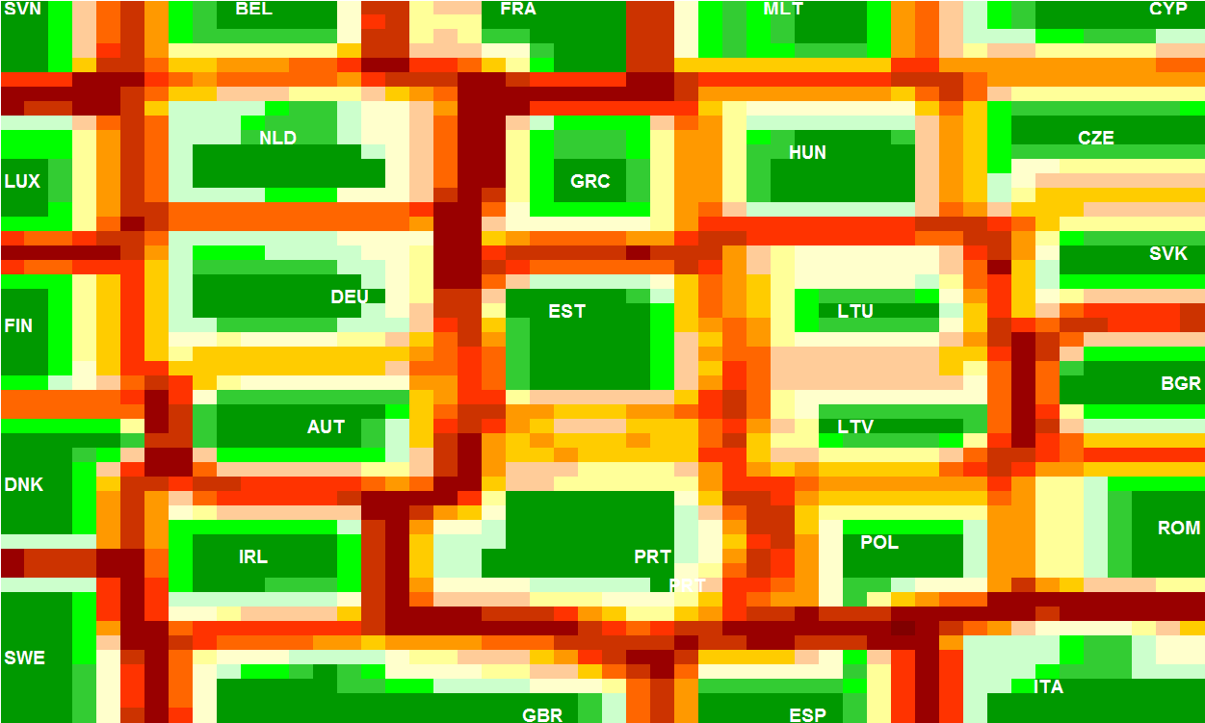
Statistical evidence: country clusters
Notes:
We tried to do some more complex analysis that included 10 different indicators, which allowed to us to create some clusters of countries. These are explained in the statistical annex of the report.

Slide 12
Corruption and
Corruption and GDP
Notes:
One example of measurable relations is GDP vs. Corruption, which is quite often analysed.

Slide 13
Statistical evidence: country clusters
Cluster 1: Denmark, Finland, Sweden
Cluster 2:
Austrian, Belgium, Germany, Ireland, Luxembourg, Slovenia, Spain, UK
Cluster 3: France
Cluster 4: Estonia, Latvia, Lithuania, Portugal
Cluster 5: Czech Republic, Cyprus, Greece, Hungary, Malta, Slovakia
Cluster 6: Italy
Cluster 7: Bulgaria, Poland, Romania
Weak link b/w corruption & OC
Strong link b/w corruption & OC
Notes:
If one distils from this statistical analysis, we get 7 groups of countries. Based on this groups we selected some countries to get a more detailed picture about the characteristics of each group.

Slide 14
Issues with statistical evidence and clusters
Unreliable data (no index on ‘organised crime’)
Data on corruption measures primarily perceptions / petty corruption
No explanations to describe the nature of the relationship
(many factors are not / are difficult to measure statistically)
Difficult clustering (unclear boundaries between clusters; single-country clusters)
Notes:
The establishment of these groups, though, is problematic, because the available indexes on corruption and organised crime are quite problematic. Practically the corruption indexes do not measure corruption related to organised crime, while the few available ‘organised crime’ indicators are largely based on perceptions, and are not reliable.

Slide 15
Institutions and corruption
Police
Judiciary
Political corruption
Customs administration
Other institutions (depending on OC activity)
Tax administration
Museums (antiquities market)
Ministries of agriculture / forest services (illegal logging)
Ministries of economy / trade (arms trafficking)
Notes:
We tackled the problem from four different angles:
Looking at how organised criminals use corruption to corrupt public institutions;
Looking at how the private sector is abused
Looking at how corruption is used within particular illegal market
Looking at specifics for particular Member States.

Slide 16
Institutions and corruption
Use of corruption by OC to target institutions
Culture / informal social relations
Anti-corruption unit
Regional specifics (pressures)
Institutional setup (powers)
Economic factors (salaries)
General level of corruption in country
Size / types of criminal market
Anti-corruption measures
Notes:
Възможно е да се дефинират, но сложно да се намерят данни – за всеки от 10-те стрелки при това достатъчно дълги редове. ... Най-простия тип анализ на корелация ...илюстрация графика – GDP vs corrup index… Значително по-сложен... При клъстерите е един първи опит след много и различни методи за клъстериране. Твърде малко изследвания по отношение на част от факторите

Slide 17
Institutions and corruption
Political corruption
Judicial corruption
Customs
Corruption
Police
corruption
Notes:
It is important to understand that although we have provided separate analyses of corruption within different institutions, most often these are inter-related, as some of these connections are shown within. Corruption politicians might try to influence the investigation and the judicial process; corrupt investigators might try to influence judges or prosecutors, or to seek political protection from prosecutions.

Slide 18
Police corruption
Use of corruption by OC to target police
Culture / informal social relations
Internal affairs
unit s
Regional specifics (pressures)
Economic factors (salaries)
General level of corruption (judicial / political corruption)
Size / types of criminal market
Anti-corruption measures
Policies on illegal markets
Immigration & OC
Notes:
One example is the issue of police corruption. On this slide you may see the different factors that influence the nature and the extent of corruption that OC might use to influence the police.

Slide 19
Political corruption
Use of corruption by OC to target politicians
Parliament corruption
Society / public perceptions
Corruption in government
Secret societies
Local level corruption
Political cycles
Political culture: patron-client relations
Class
Political instability
Politisized administration
Notes:
One example is the issue of police corruption. On this slide you may see the different factors that influence the nature and the extent of corruption that OC might use to influence the police.

Slide 20
Private sector corruption: illegal market business cycle
Production / Procurement
Cigarette factories managers
Trafficking
Transport companies
Laundering of criminal proceeds
Notaries
Distribution
Retail store managers
Car-factory / dealer employee
Museum workers
Chemical plant workers
Security staff at ports
Bank employees
Exchange bureau employee
Dance club employees (security staff)
Service staff at airports
Gambling facility employee
Notes:
- Council Framework Decision 2003/568/JHA on combating corruption in the private sector has not been implemented everywhere.
- No state monitoring of private sector corruption exists in most member states.
- Difficulty in defining or analyzing the involvement of professional services (lawyers, accountants, real-estate staff);
Real-estate, entertainment industry, gambling are often associated with organised crime, but corruption is one of the issues. Most often organised criminals run themselves companies in these industries, so there is no need for corruption.
This slides shows how private sector corruption plays a role within different segments of an illegal market.

Slide 21
Illegal market / OC activity and corruption
Use of corruption by OC
Culture / informal social relations
Type of illegal market
Regional specifics (pressures)
Effectiveness of law-enforcement
Economic factors (salaries)
Government policies (taxes, illegality)
Grey economy
Anti-corruption measures
Volume of trade / infrastructure
Notes:
Another approach we took was to see how corruption is used within particular illegal markets. Here you may see the numerous factors that might influence the intensity and the nature of organised crime and corruption.

Slide 22
Trafficking in human beings and corruption
Recruitment
Transport
Exploitation
Laundering
Stores, transport companies,
Law firms – arranged marriages;
Work/travel agencies
Border Police
Counselor services - visa applications
Police officers – protection and non-interference
Local authorities – licensing of premises, prostitutes
Financial: change bureaus;
Car-dealers
Notes:
One example could be the use corruption within the trafficking of human beings.

Slide 23
Case studies: France
Data issues & taboos
Organised crime
Sizeable illegal markets
Regions with specific history (South-east, Corsica, territories)
Social factors:
Class structure: elites
History
Police: defining corruption, little data, and indicative cases
Politicians : thing of the 90s?; white collar criminals
Judiciary : zero corruption?
Notes:
As noted above the ‘cluster analysis’ that we did left us with some single countries, that were ‘stand alone clusters’. France is a typical case-study where we met the difficulties which we would have met in many Member States: lack of studies (the latest comprehensive analysis concerned a period before 1990 and did not address the issue of organised crime); lack of official information and analysis;
The indications were that there were sizeable illegal markets and regions (Corsica or Marseille) with significant OC presence. In addition various political scandals indicated that corporate crime and corruption is an issue.
Some of the explanations provided included, the social class structure in France – with strong elites and relations within them that facilitate white-collar crime, and a traditional criminal class that usually has connections to police corruption.
The recent court cases on police and judicial corruption are indicative of larger problems and call for more careful look into the problem of corruption in France.

Slide 24
Recommendations to EC: independent corruption monitoring
Corruption
monitoring
mechanism
Independent information collection
Data collection tools
Benchmarking indicators
Collect data on anti-corruption units
Alternative sources of information
Independent EU agency
Notes:
Recommendations do not include anti-corruption measures and policies, as due to national specifics it is difficult to recommend one-size-fits-all
Presently there is no available data in Member States, that would allow for Europol OCTA type report. In fact, the OCTA methodology, which includes detailed questions on corruption, only confirms that a ‘self-reporting’ mechanism is not appropriate (as theoretically it should have provided sufficient information to the EC, and this present study would not have been necessary)
Our recommendation on a monitoring mechanism is presented schematically here, with the key elements that suc a system should include.

Slide 25
Recommendations to EC
Move closer to a common definition of corruption
Harmonise statistics on institutional corruption
EU Survey to assess the level and impact of crimes against business
Increase funding support for empirically based research on corruption
Developing practical anti-corruption training programmes (through DG JLS grant instruments)
Notes:
We have provided a range of cheaper measures that might help with providing some partial insight with the situation:
Using diversity and experience (UK – Police corruption; Sweden / - public pressures / culture of non-corruption;)
Article 83 of the Lisbon Treaty (developing ‘minimum rules concerning the definition’ of corruption in Member States legislation) the EC should develop detailed guidelines to encompass a broad range of criminal offenses under the definition of corruption

Slide 26
Recommendations to Member States
Conduct impact evaluation of anti-corruption policies
Sharing information with the public
Institutional monitoring mechanisms
Increasing internal institutional detection capacities
Improve OC awareness of anti-corruption bodies
Training and awareness raising amongst public servants
Working with the private sector

Slide 27
Belgian approach: data on OC ‘influence’
Notes:
This chart is just one example how some member states analyse data on OC use of corruption. In Belgium all cases on OC investigations (b/w 200 and 300) per year, analyse in how many cases, some type of influence was attempted or used. This not necessarily means that there is ‘court-type’ evidence on such use, but that there is . The Belgian OCTA provides quite a bit of analysis of trends in terms of the types of categories (police, customs, lawyers, politicians, lawyers, etc).

Slide 28
Further information
www.csd.bg
Philip Gounev
philip.gounev@csd.bg
Ruslan Stefanov
ruslan.stefanov@csd.bg
Alexander Stoyanov
alex@csd.bg

Slide 29
Private sector corruption: scope
External fraud
External fraud with collusion inside
External fraud by OC with collusion inside
Internal fraud
Notes:
The definition of private sector corruption is problematic. Usually, ‘private sector’ corruption is discussed in terms of ‘fraud’. We were interested in only one specific aspect of ‘fraud’, when the ‘corruptor’ was outside the company (i.e. we have ‘external fraud with collusion on the inside), but this outside corruptor was associated with organised crime.

Slide 30
Police corruption
Type | Grid | Group | Description | MS observed
Donkeys | Strong | Weak | work characterised by both isolations and subordination: individual deviance of lower level officer | All EU
Hawks (rotten apples) | Weak | Weak | a lot of freedom, distance from organisation, individual deviance (example: higher rank officers or officers working on highly confidential material) | FR, ES, UK, IT, SL, SE, NL, AU, BE, EI, DE
Wolves | Strong | Strong | strong group identity creates a subculture that facilitates organised deviance; group protection against external controls | FR, ES, IT, RO, CZ, BG, PT
Vultures | Weak | Strong | freedom to aggressively seek exploitable situations, using the cover offered by the group | BG, EL, RO, CZ, LT, LA, CY, PO
Notes:
One possible approach to analysing the problem is to use the matrix developed by Hank van de Bunt:
Grid: ‘the extent to which an (occupational) culture imposes its social categories on the workers and therefore fixes their appropriate behavior and the behavior of others towards them, ie. the amount of autonomy and discretion afforded
Group (strong ties and social control or not): ‘the strength varies with the frequency with which workers interact with each other, mutuality of the contacts between the members of the group, the extensiveness of the contacts, and the presences of boundaries between the group and the outside world’,
From the partial data that we obtained we were able to see that some types of corruption are more dominant in some member states than in others.

